Slide 1
The effect of balancing methods on model behaviour in NLP imbalanced classification problems
Maciej Pawlikowski
Supervisors: PHD Anna wróblewska, PhD Daniel dan

Slide 2
Idea
We know that balancing methods improve the ability of the model to discriminate between classes.
Are models created using those methods calibrated?
But how do they affect models behaviour?
Do they behave differently? Did their explanation change?
There are studies tackling those questions, but they are made for tabular data. I will work with NLP

Slide 3
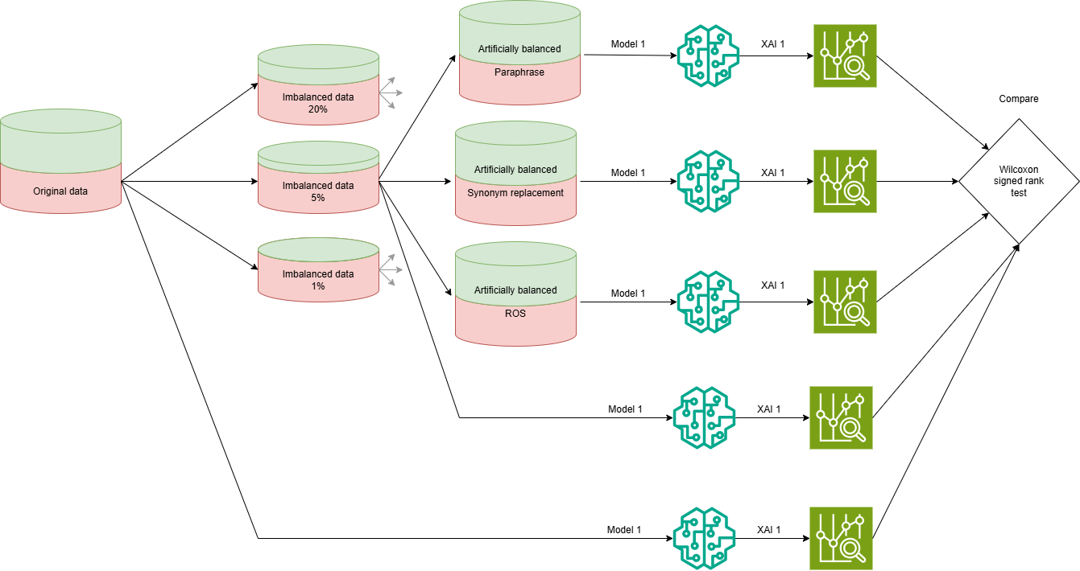
Methodology

Slide 4
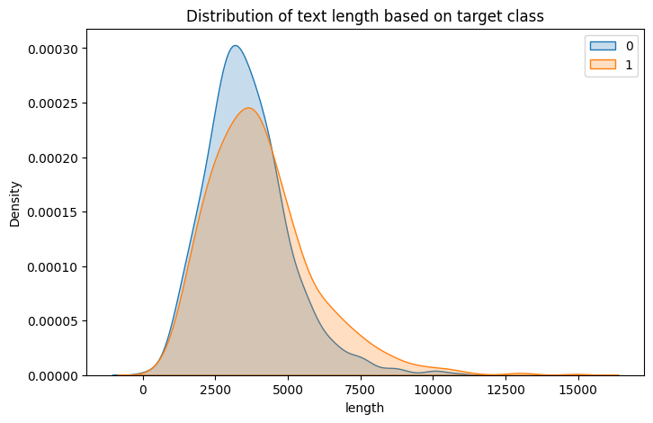
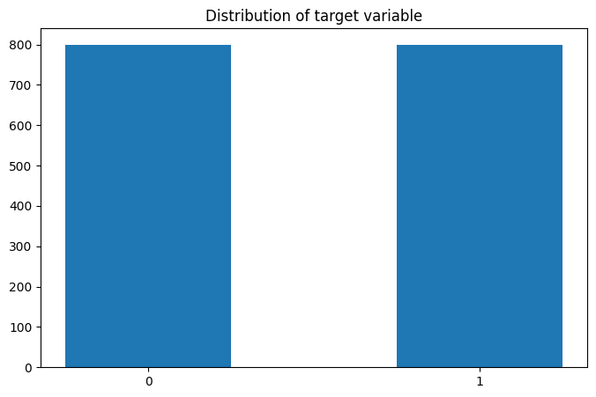
Dataset ERASER- movies

Slide 5
Imbalancing the data

Slide 6
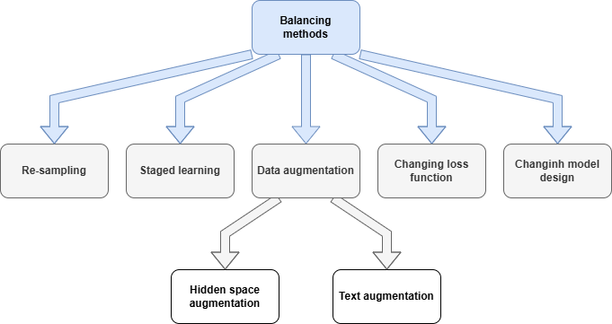
Balancing methods

Slide 7
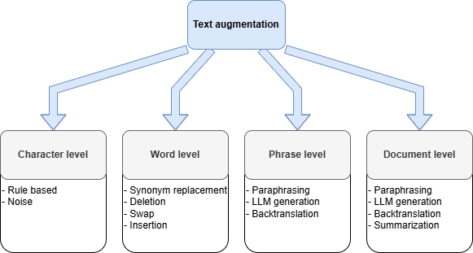
Balancing methods

Slide 8
Models + encoding
SVM + TF-IDF
LSTM + keras tokenizer (One Hot Encoder)
DistilBERT (DistilBERT encoder)

Slide 9
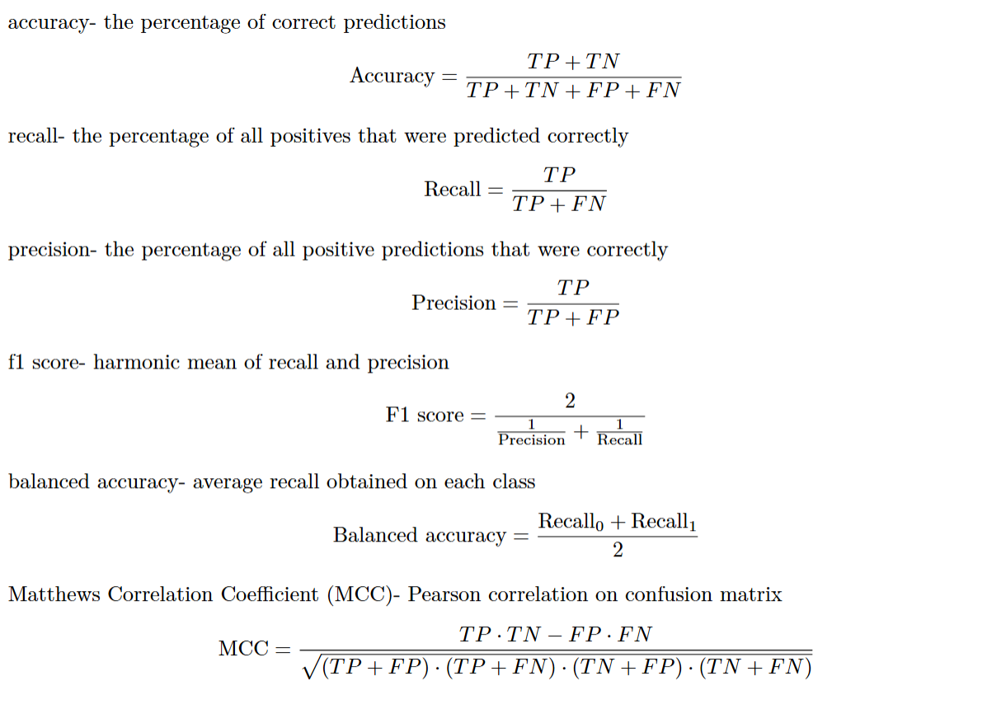
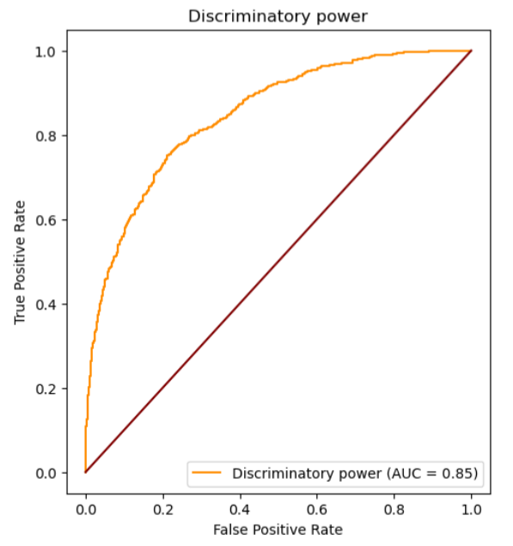
Discriminatory power

Slide 10

Calibration Definition
$\hat{p}=p$

Slide 11
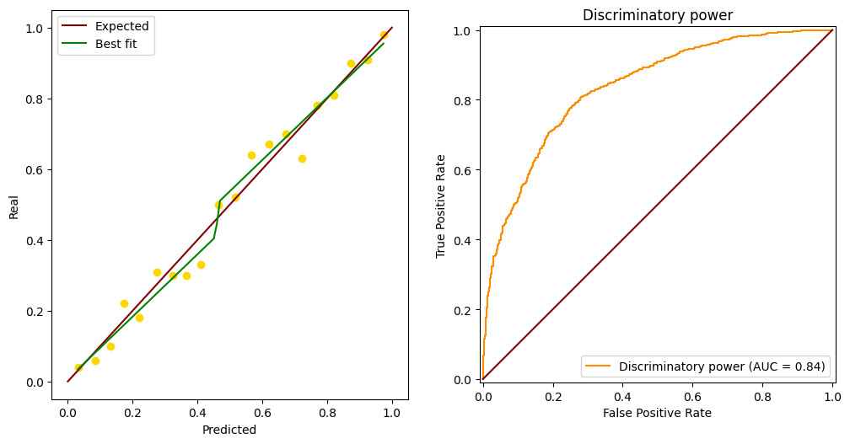
Calibration Evaluation

Slide 12
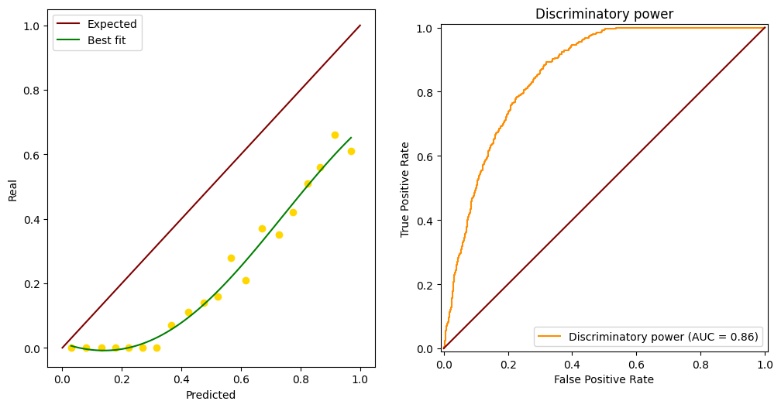
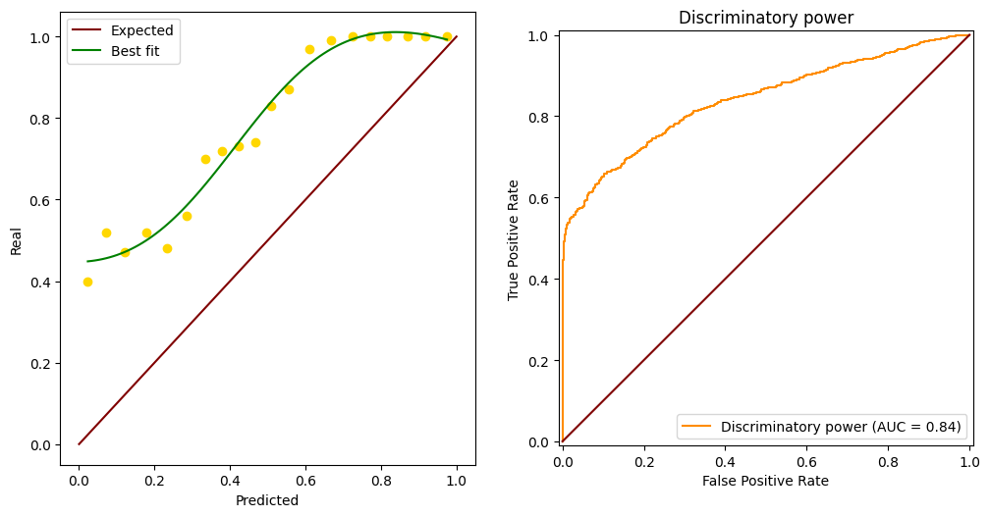
Calibration Evaluation

Slide 13
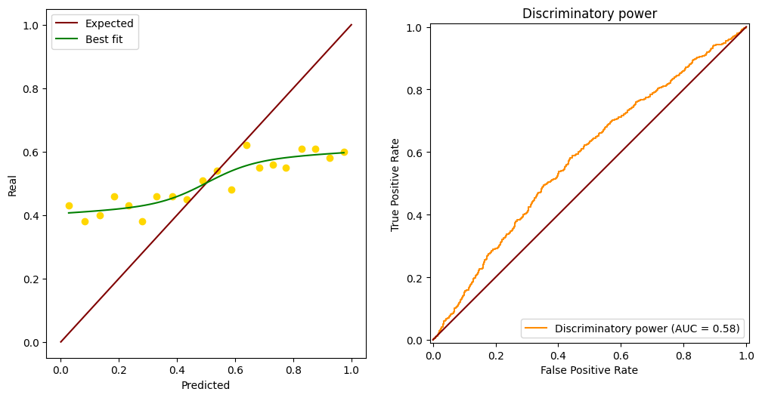
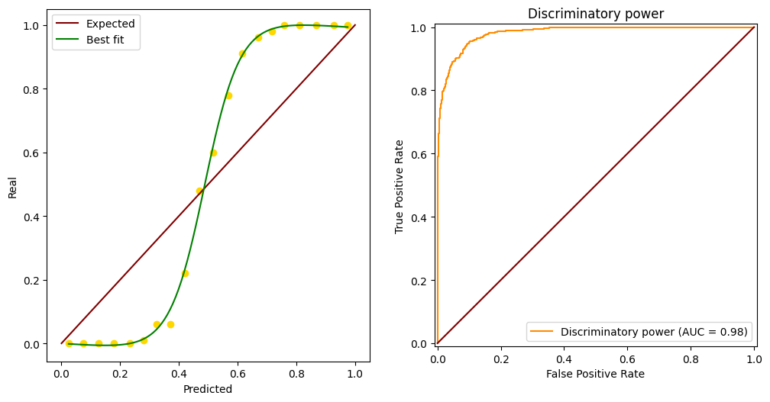
Calibration over-/under-fitting

Slide 14
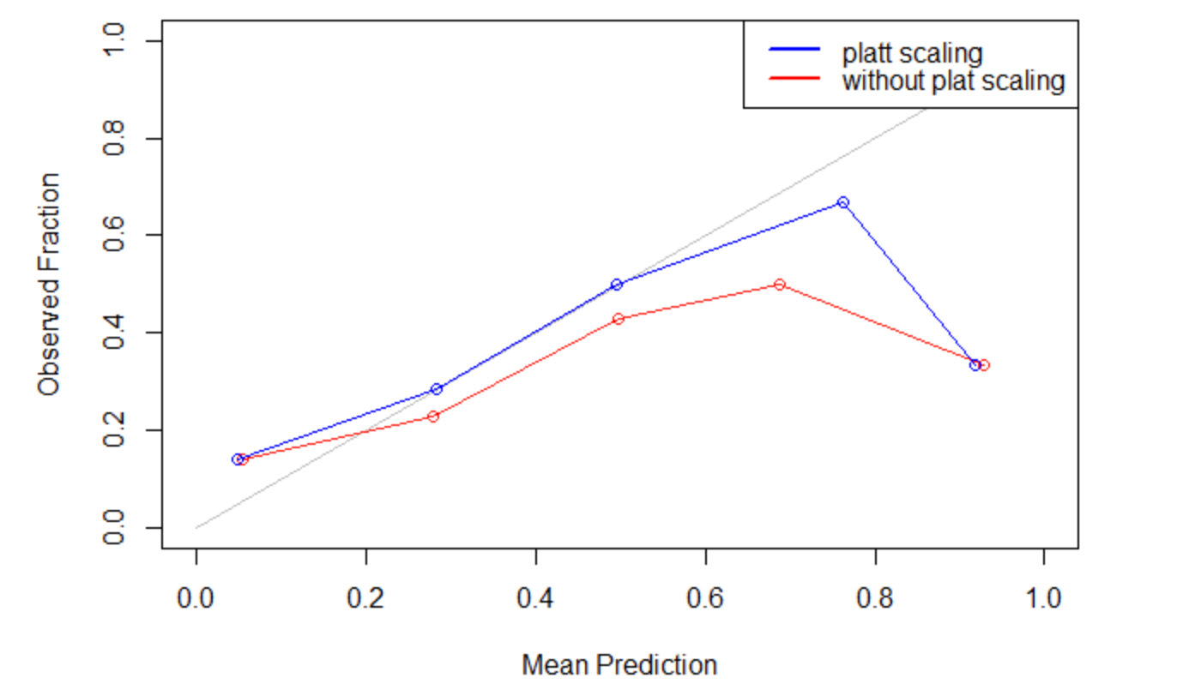
Calibration Recalibration
https://medium.com/@chandu.bathula16/machine-learning-concept-68-platts-scaling-b8245421739e

Slide 15
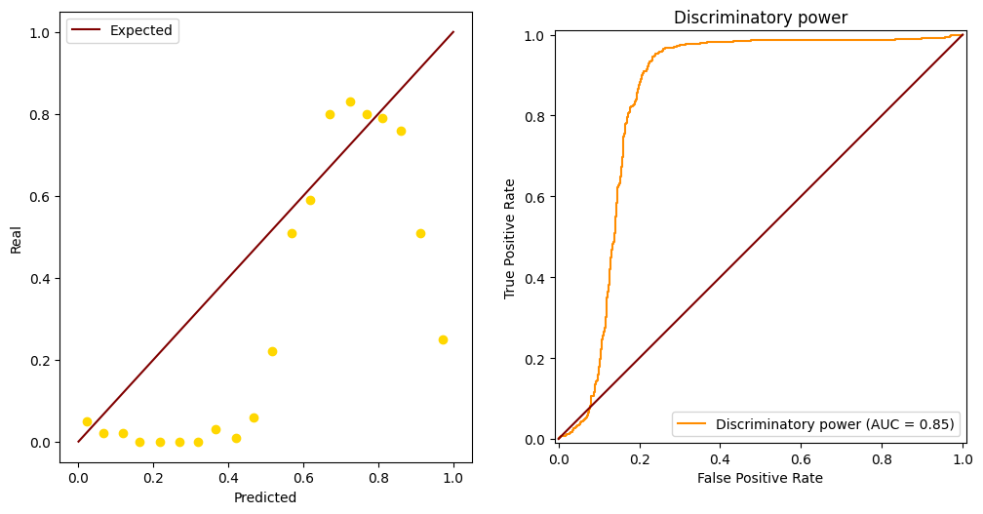
Uncalibrated model

Slide 16
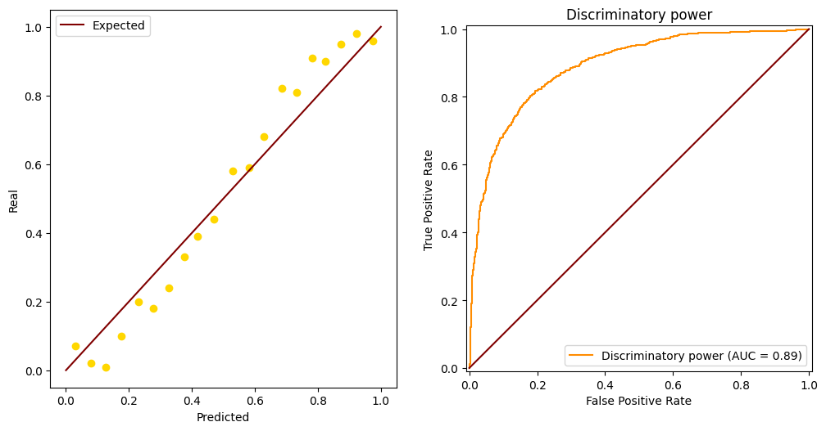
Calibration Imbalanced problem

Slide 17
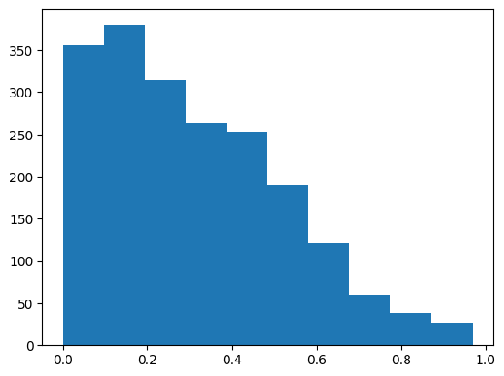
Calibration Imbalanced problem

Slide 18
Calibration Imbalanced problem

Slide 19
Calibration Imbalanced problem

Slide 20
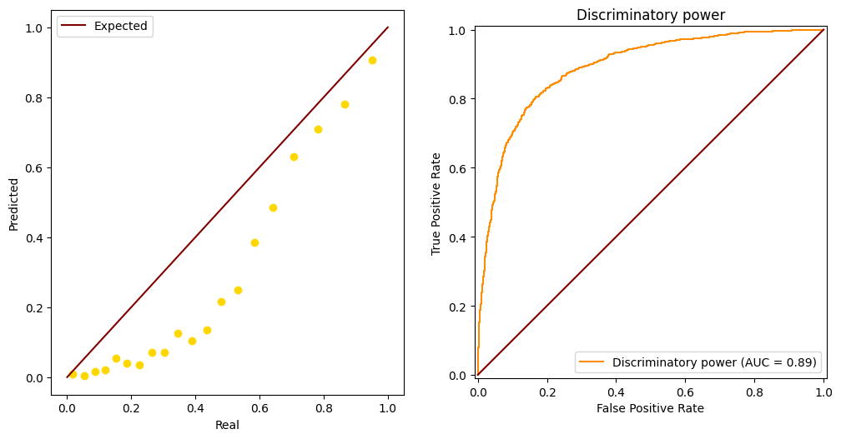
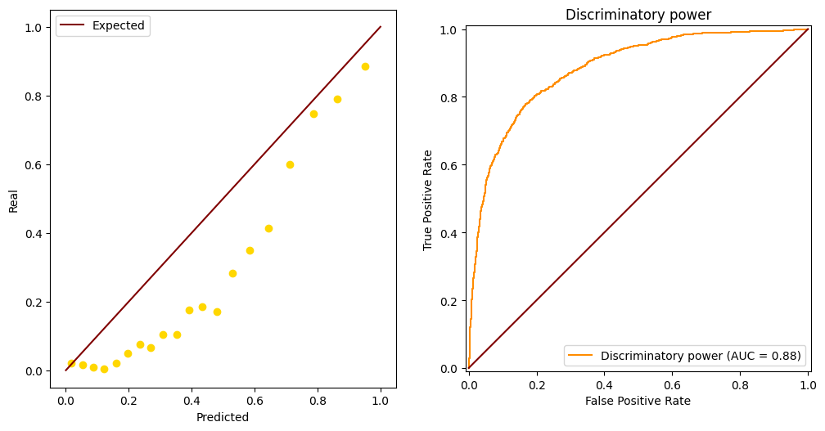
Calibration Imbalanced problem

Slide 21
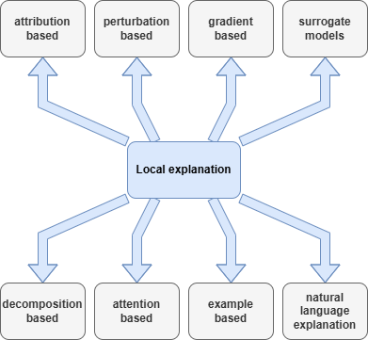
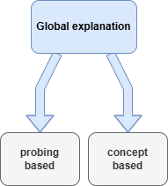
XAI

Slide 22
XAI
LIME

Slide 23
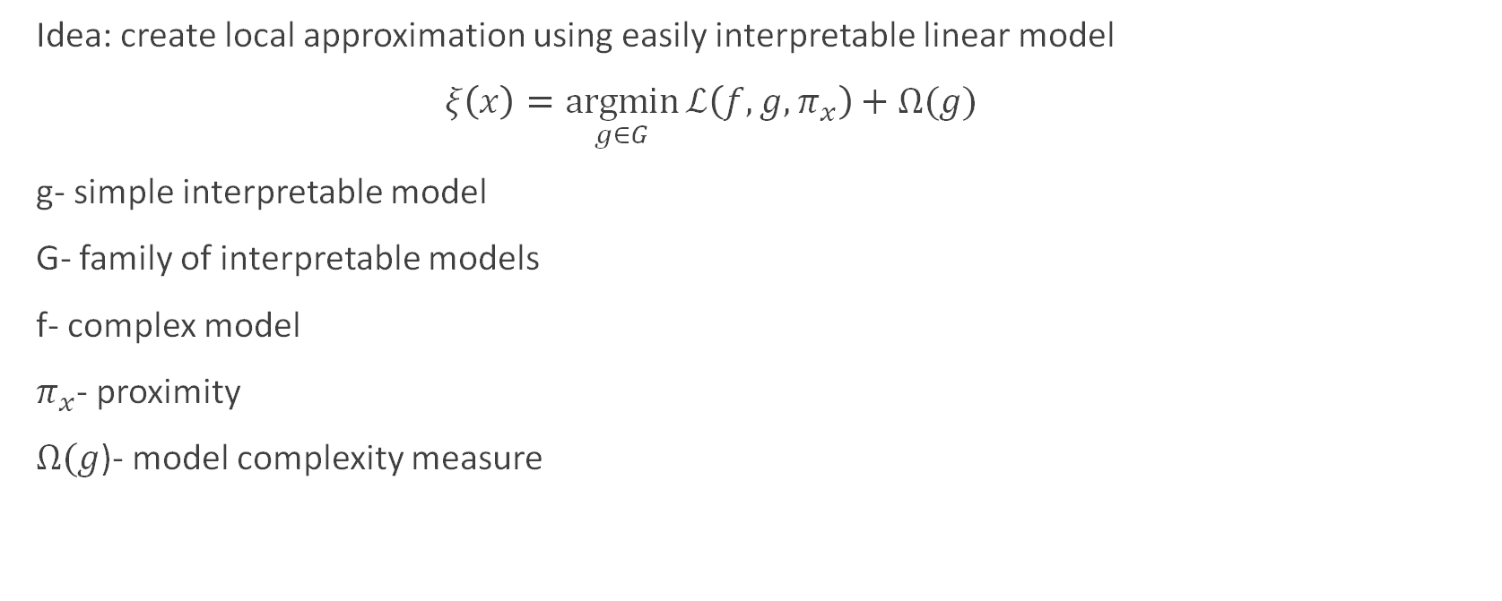
XAI Local Interpretable Model-agnostic explanations (LIME)
Idea: create local approximation using easily interpretable linear model
$ξ\left(x\right)=\underset{g∈G}{argmin}{ℒ\left(f, g, π_{x}\right)+Ω(g)}$
g- simple interpretable model
G- family of interpretable models
f- complex model
$π_{x}$- proximity
$Ω(g$)- model complexity measure

Slide 24
XAI- evaluation
Original
[CLS] i went and saw this movie last night after being coaxed to by a few friends of mine. i'll admit that i was reluctant to see it because from what i knew of ashton kutcher he was only able to do comedy. i was wrong. kutcher played the character of jake fischer very well, and kevin costner played ben randall with such professionalism. the sign of a good movie is that it can toy with our emotions. this one did exactly that. the entire theater (which was sold out) was overcome by laughter during the first half of the movie, and were moved to tears during the second half. while exiting the theater i not only saw many women in tears, but many full grown men as well, trying desperately not to let anyone see them crying. this movie was great, and i suggest that you go see it before you judge. [SEP]
Imbalanced
[CLS] i went and saw this movie last night after being coaxed to by a few friends of mine. i'll admit that i was reluctant to see it because from what i knew of ashton kutcher he was only able to do comedy. i was wrong. kutcher played the character of jake fischer very well, and kevin costner played ben randall with such professionalism. the sign of a good movie is that it can toy with our emotions. this one did exactly that. the entire theater (which was sold out) was overcome by laughter during the first half of the movie, and were moved to tears during the second half. while exiting the theater i not only saw many women in tears, but many full grown men as well, trying desperately not to let anyone see them crying. this movie was great, and i suggest that you go see it before you judge. [SEP]
ROS
[CLS] i went and saw this movie last night after being coaxed to by a few friends of mine. i'll admit that i was reluctant to see it because from what i knew of ashton kutcher he was only able to do comedy. i was wrong. kutcher played the character of jake fischer very well, and kevin costner played ben randall with such professionalism. the sign of a good movie is that it can toy with our emotions. this one did exactly that. the entire theater (which was sold out) was overcome by laughter during the first half of the movie, and were moved to tears during the second half. while exiting the theater i not only saw many women in tears, but many full grown men as well, trying desperately not to let anyone see them crying. this movie was great, and i suggest that you go see it before you judge. [SEP]
Paraphrase
[CLS] i went and saw this movie last night after being coaxed to by a few friends of mine. i'll admit that i was reluctant to see it because from what i knew of ashton kutcher he was only able to do comedy. i was wrong. kutcher played the character of jake fischer very well, and kevin costner played ben randall with such professionalism. the sign of a good movie is that it can toy with our emotions. this one did exactly that. the entire theater (which was sold out) was overcome by laughter during the first half of the movie, and were moved to tears during the second half. while exiting the theater i not only saw many women in tears, but many full grown men as well, trying desperately not to let anyone see them crying. this movie was great, and i suggest that you go see it before you judge. [SEP]
low negative LIME
high positive LIME

Slide 25

Wilcoxon- signed rank test
$H_{0}:\text{there} \text{is} \text{no} \text{difference} \text{between} \text{two} \text{samples}$
$T=\sum_{i=1}^{N}{\operatorname{sign}\left(X_{i}\right)R_{i}}$

Slide 26
XAI Evaluation
 | Original-Imbalanced | Original-ROS | Original-paraphrase | Imbalanced-ROS | Imbalanced-paraphrase | ROS-paraphrase
Review 0 | 0.026 | 0.060 | 0.000 | 0.628 | 0.848 | 0.801
Review 1 | 0.000 | 0.000 | 0.000 | 0.008 | 0.139 | 0.167
Review 2 | 0.009 | 0.436 | 0.000 | 0.046 | 0.003 | 0.000
Review 3 | 0.003 | 0.070 | 0.001 | 0.988 | 0.485 | 0.307
Review 4 | 0.002 | 0.023 | 0.025 | 0.751 | 0.840 | 0.212
Review 5 | 0.000 | 0.528 | 0.000 | 0.001 | 0.549 | 0.000
Review 6 | 0.034 | 0.352 | 0.024 | 0.975 | 0.259 | 0.555
Review 7 | 0.026 | 0.328 | 0.000 | 0.893 | 0.194 | 0.500
Review 8 | 0.696 | 0.423 | 0.001 | 0.495 | 0.185 | 0.125
Review 9 | 0.000 | 0.554 | 0.000 | 0.011 | 0.046 | 0.001
Review 10 | 0.113 | 0.007 | 0.099 | 0.110 | 0.514 | 0.378
Review 11 | 0.244 | 0.098 | 0.137 | 0.251 | 0.542 | 0.504
Review 12 | 0.317 | 0.158 | 0.016 | 0.395 | 0.052 | 0.770
Review 13 | 0.665 | 0.717 | 0.001 | 0.685 | 0.011 | 0.099
Review 14 | 0.098 | 0.000 | 0.823 | 0.000 | 0.267 | 0.000
Review 15 | 0.016 | 0.778 | 0.000 | 0.358 | 0.034 | 0.024
Review 16 | 0.198 | 0.000 | 0.001 | 0.000 | 0.000 | 0.000
Review 17 | 0.000 | 0.000 | 0.000 | 0.000 | 0.000 | 0.093
P-value
< 0.05
0.05- 0.1
> 0.1

Slide 27
XAI Evaluation
Average p-value
Median p-value
Null hypothesis rejection rate
Original-Imbalanced | Original-ROS | Original-paraphrase | Imbalanced-ROS | Imbalanced-paraphrase | ROS-paraphrase
0.105123 | 0.299009 | 0.036601 | 0.327422 | 0.242081 | 0.235716
0.0260109 | 0.2014737 | 0.0003060 | 0.2512452 | 0.0510351 | 0.0960921
0.625 | 0.350 | 0.850 | 0.275 | 0.500 | 0.450

Slide 28
ERASER
LIME
[CLS] there're so many things to criticize about i do n't know where to start. recommendation: turn off your brain - do n't be like me, decreasing the rating everyday because i think about it too much. a comet is about to strike earth, causing a catastrophe similar to the extinction level event (e. l. e.) that wiped out the dinosaurs. what follows is the story of a president's bid to think for the good of his people, a rising reporter, the love story of two teenagers (one of whom discovered the comet), and a team of astronauts on the ship ` messiah'to save the world. firstly, there is nothing outstandingly inferior about the making of the film (nor is there anything outstandingly good about it), but the plot holes make the film corny and stupid. to be honest, i was more moved by the trailer than the film itself (which is n't saying much). mimi leder's follow - up to ` the peacemaker'is equally incompetent, with all the big stars wasted. (perhaps i'm just annoyed that the release of ` the peacemaker'in the us overshadowed a far superior thriller, ` the assignment'.) it is very obvious that the title not only represents the big boom that will result from the collision, but also connotes the heavy impact on human lives. however, the film simply fails on that note. the effects are worn - out, the substandard screenplay limited the acting, and the director continued her sad run in terms of good - film - making credentials. she's still making good money though. t ? a leoni's unfortunate character, the news reporter, is the foundation of the story and of the cast. but the film suffers from too many characters that do not need to be explored. robert duvall's aging astronaut is lifeless, and morgan freeman's president is restricted to, well, a righteous president (which means he's not interesting at all). leoni's character is the only appealing one, and is played with reasonable conviction (but a rather peculiar showing when reporting for msnbc), but was definitely undervalued by the director and screenwriters. warning: spoilers included (but a lot of it is irrelevant and predictable anyway). plot holes, plot holes, plot holes. now, e. l. e. is threatening to exterminate more than 99 % of the human race, [SEP]
Human
[CLS] there're so many things to criticize about i do n't know where to start. recommendation: turn off your brain - do n't be like me, decreasing the rating everyday because i think about it too much. a comet is about to strike earth, causing a catastrophe similar to the extinction level event (e. l. e.) that wiped out the dinosaurs. what follows is the story of a president's bid to think for the good of his people, a rising reporter, the love story of two teenagers (one of whom discovered the comet), and a team of astronauts on the ship ` messiah'to save the world. firstly, there is nothing outstandingly inferior about the making of the film (nor is there anything outstandingly good about it), but the plot holes make the film corny and stupid. to be honest, i was more moved by the trailer than the film itself (which is n't saying much). mimi leder's follow - up to ` the peacemaker'is equally incompetent, with all the big stars wasted. (perhaps i'm just annoyed that the release of ` the peacemaker'in the us overshadowed a far superior thriller, ` the assignment'.) it is very obvious that the title not only represents the big boom that will result from the collision, but also connotes the heavy impact on human lives. however, the film simply fails on that note. the effects are worn - out, the substandard screenplay limited the acting, and the director continued her sad run in terms of good - film - making credentials. she's still making good money though. t ? a leoni's unfortunate character, the news reporter, is the foundation of the story and of the cast. but the film suffers from too many characters that do not need to be explored. robert duvall's aging astronaut is lifeless, and morgan freeman's president is restricted to, well, a righteous president (which means he's not interesting at all). leoni's character is the only appealing one, and is played with reasonable conviction (but a rather peculiar showing when reporting for msnbc), but was definitely undervalued by the director and screenwriters. warning: spoilers included (but a lot of it is irrelevant and predictable anyway). plot holes, plot holes, plot holes. now, e. l. e. is threatening to exterminate more than 99 % of the human race, [SEP]
low negative LIME
high positive LIME
human rationales

Slide 29
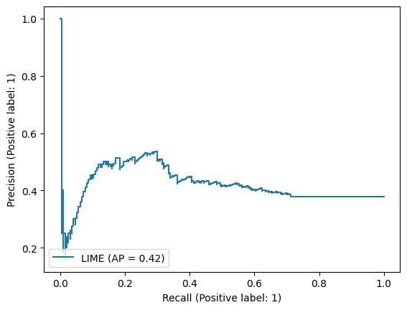
ERASER

Slide 30
Results

Slide 31
Massive amount of models
Number of datasets
n
Balancing methods
8
Imbalancing
Proportion
3
Model architectures
3
81 n

Slide 32
Massive amount of models
81 n
Repeat of experiments
5
Original model
3
408 n

Slide 33
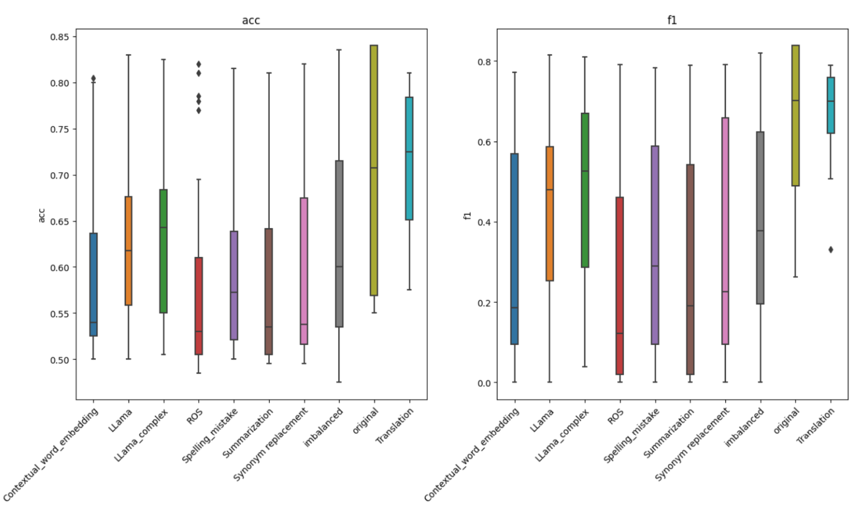
Initial results

Slide 34
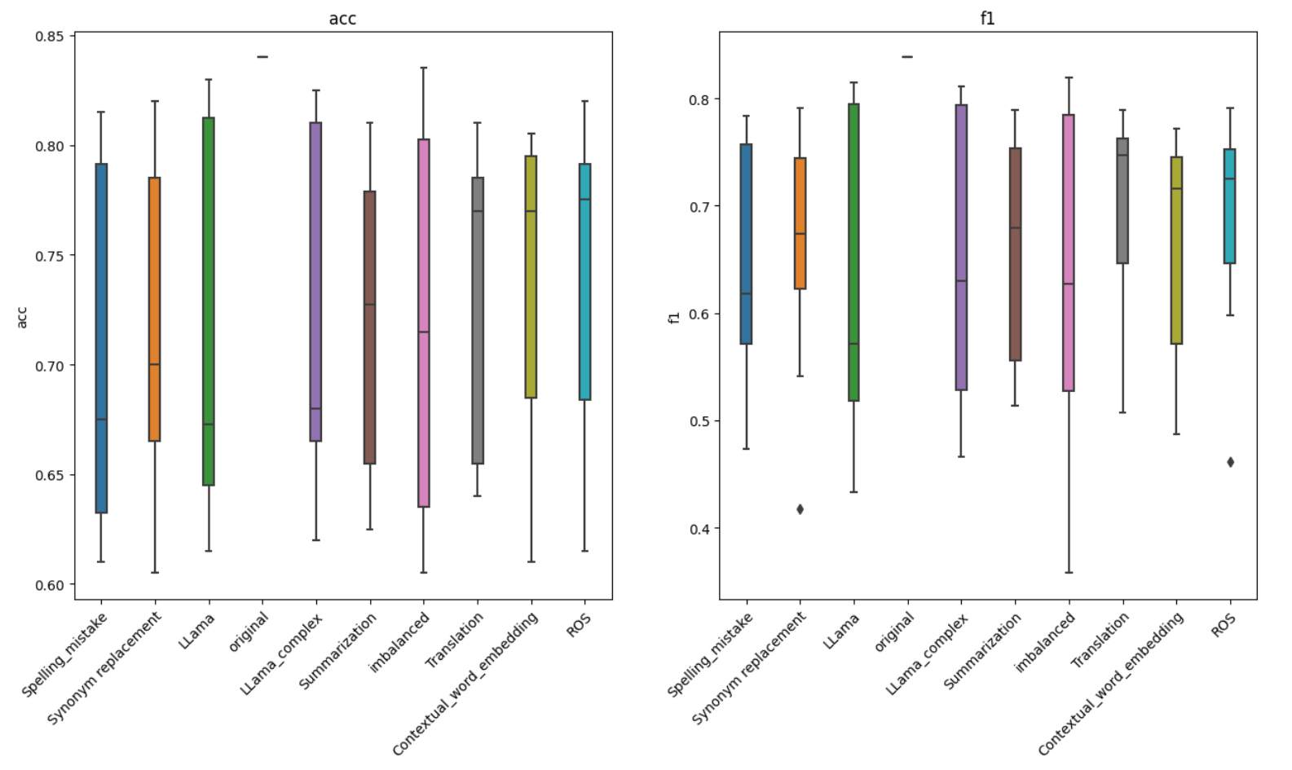
Removal of bad models
F1 != 0
Accuracy > 0.6

Slide 35
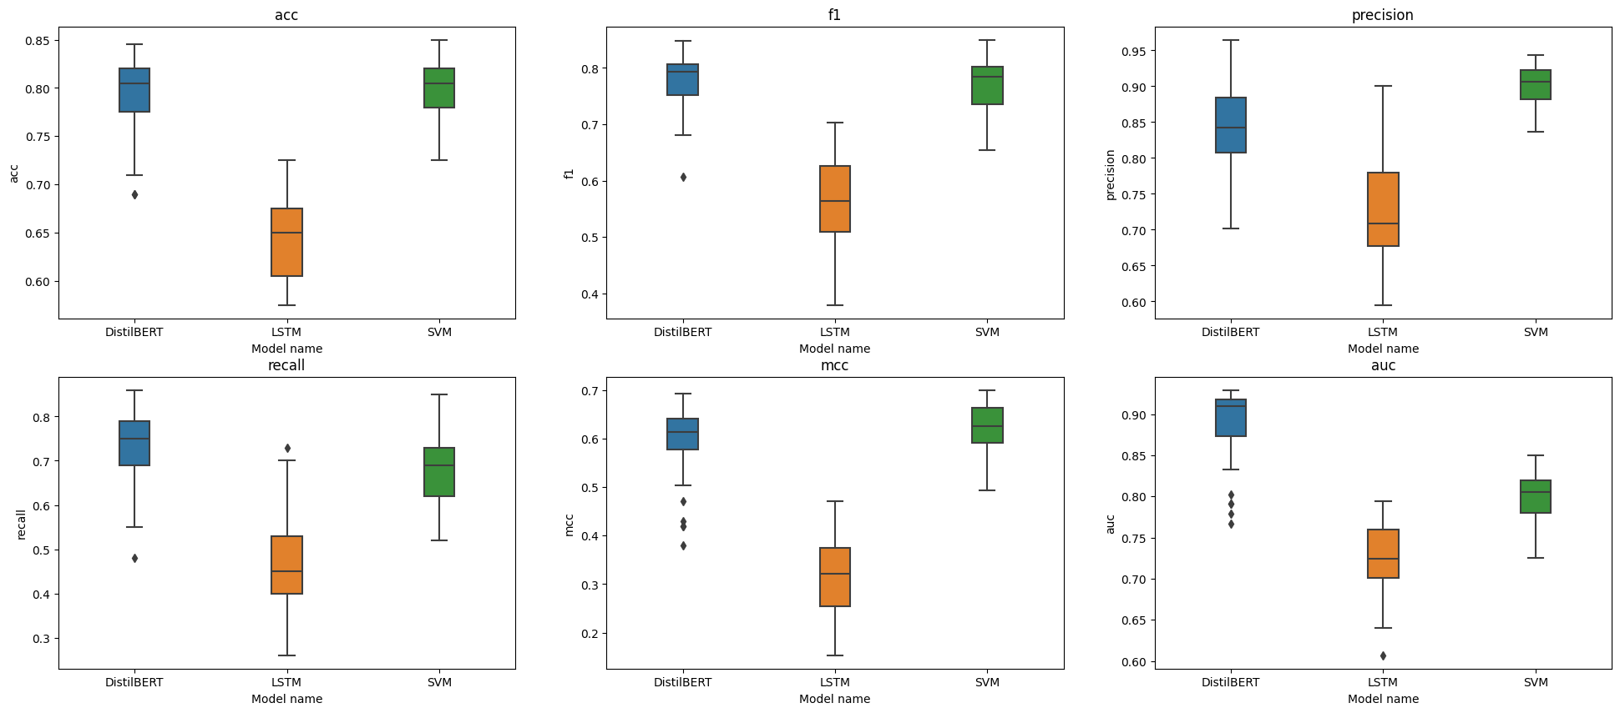
Discriminatory power
* Results based on experiments with 50% imbalance ratio. For other ratios DistilBERT is still training

Slide 36
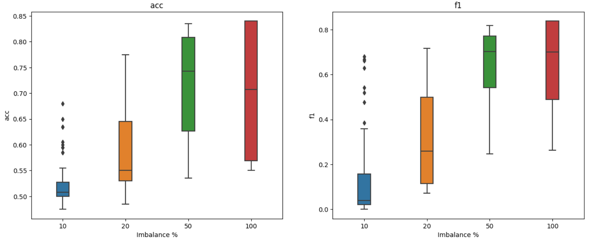
Discriminatory power

Slide 37
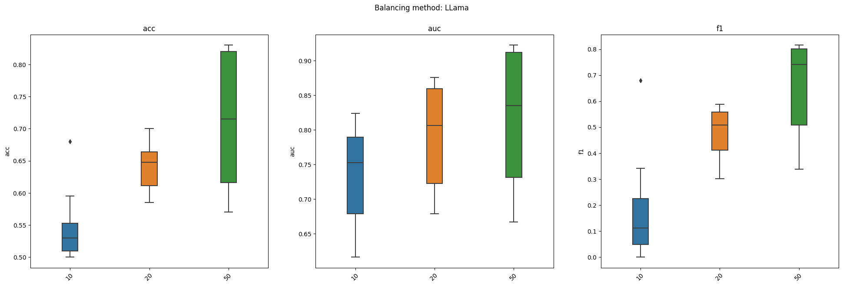
Discriminatory power- LLAMA balanced
* Results based on all experiments with all models (SVM, LSTM, DistilBERT)

Slide 38
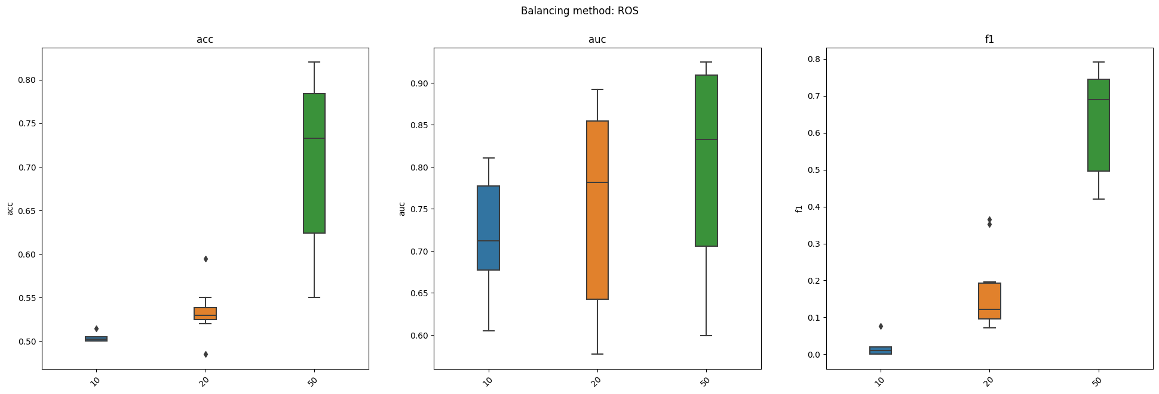
Discriminatory power- ROS balanced
* Results based on all experiments with all models (SVM, LSTM, DistilBERT)

Slide 39
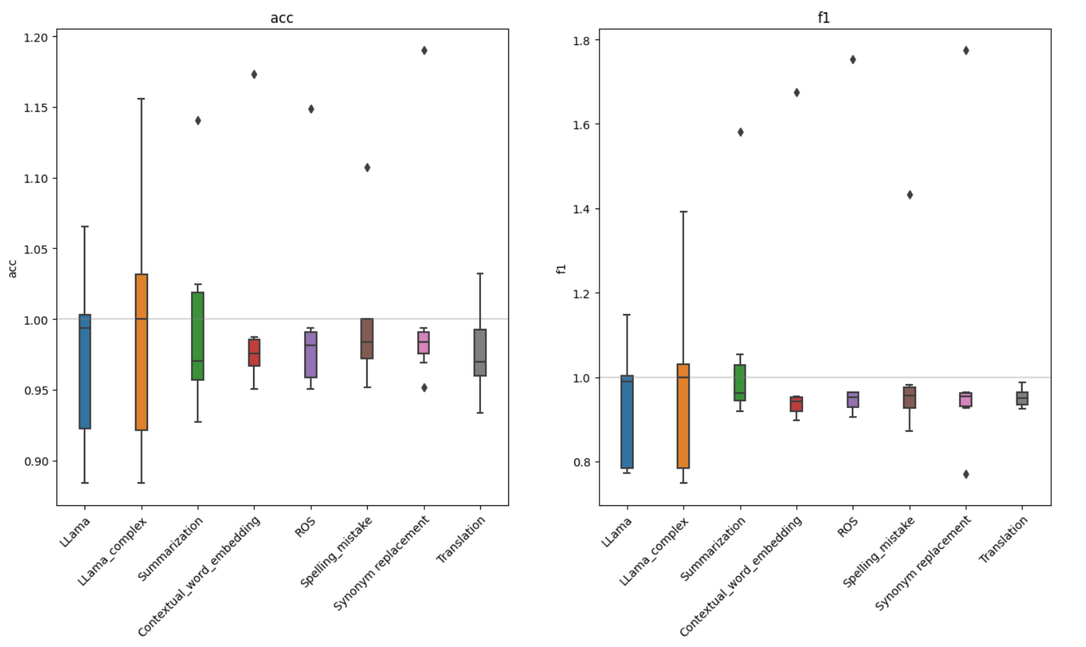
Discriminatory power Relative to imbalanced model
* This experiment was again performed only on working models and required not terrible imbalanced models (acc>0.6)

Slide 40
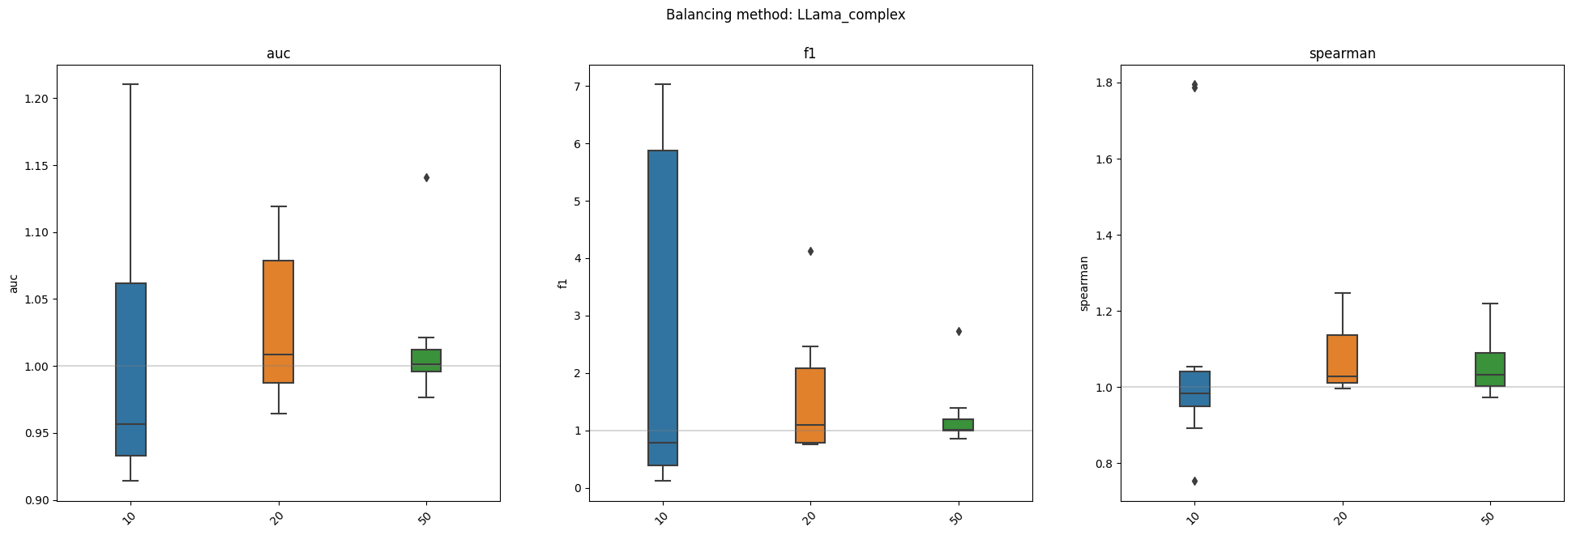
Discriminatory power Is adding class weights enough?

Slide 41
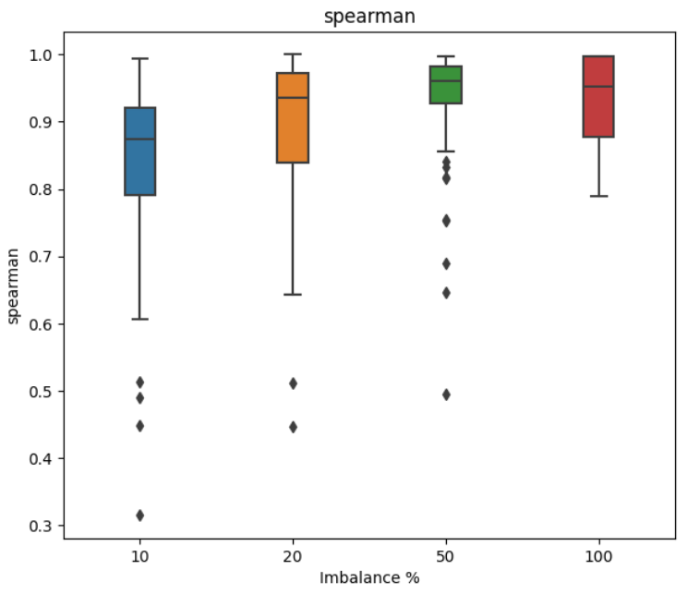
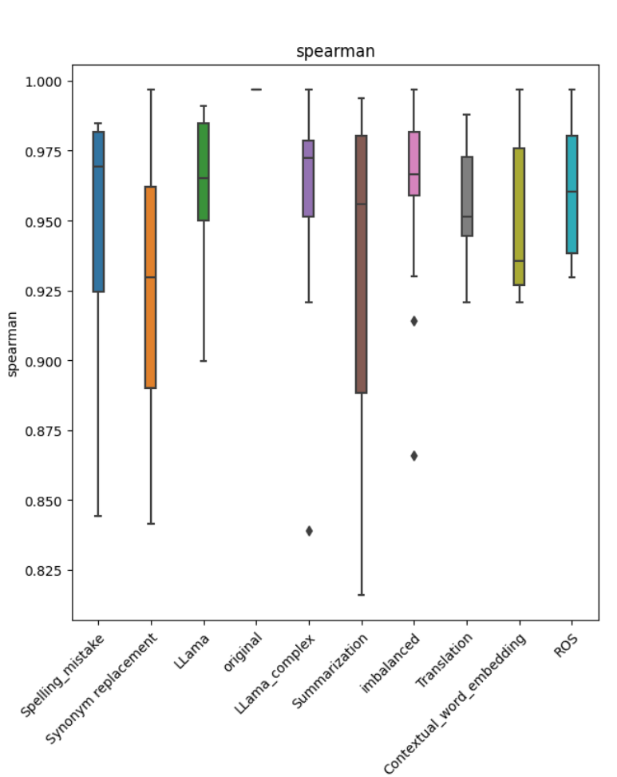
Calibration

Slide 42
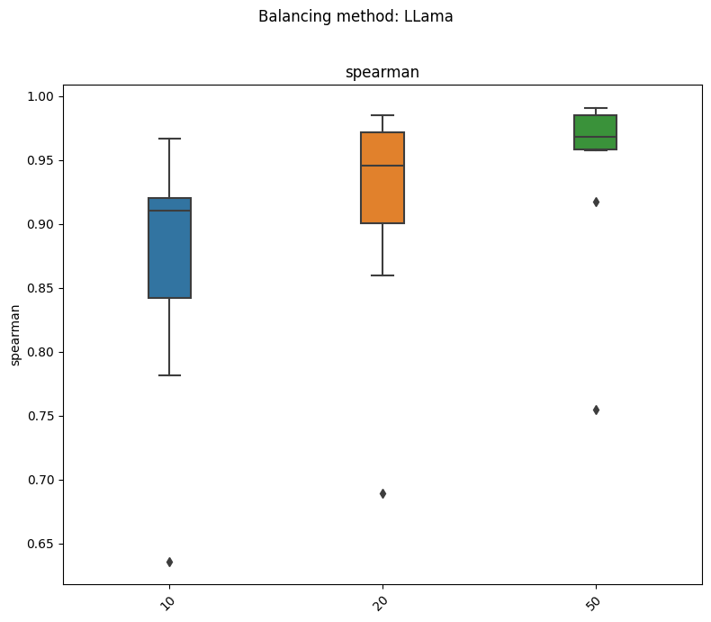
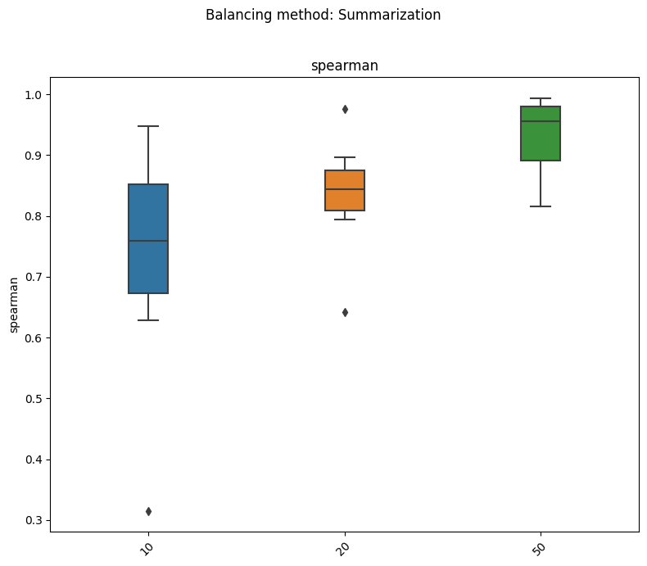
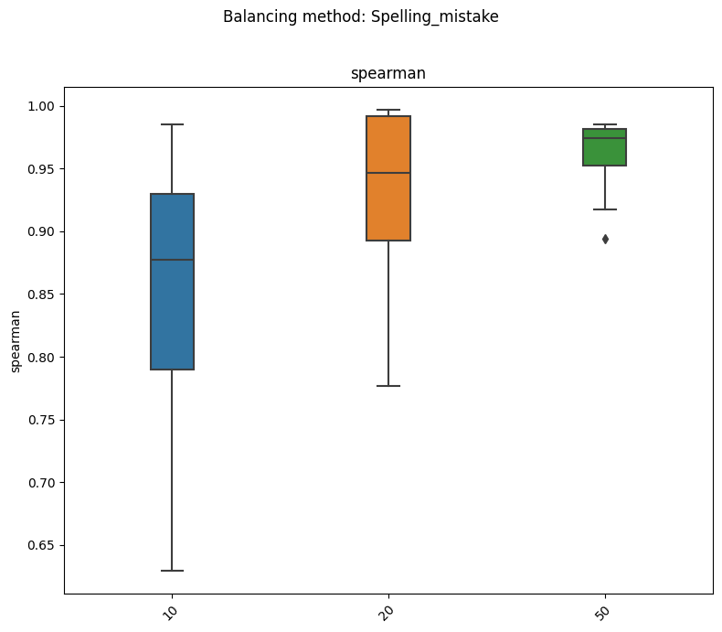
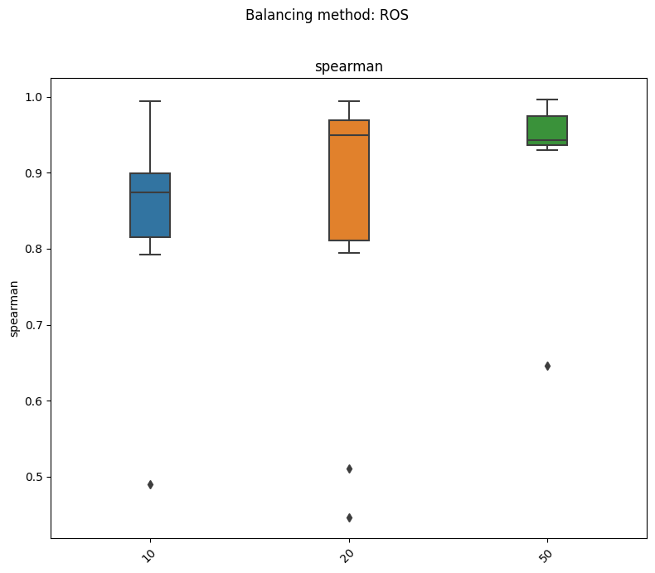
Calibration

Slide 43
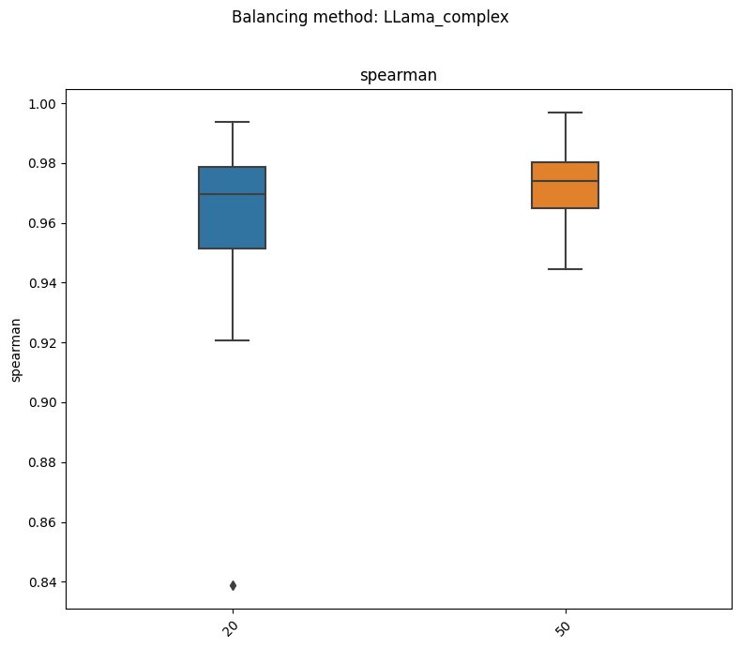
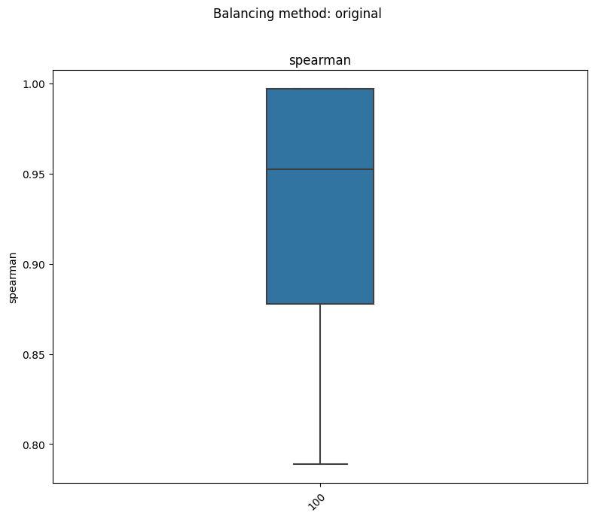
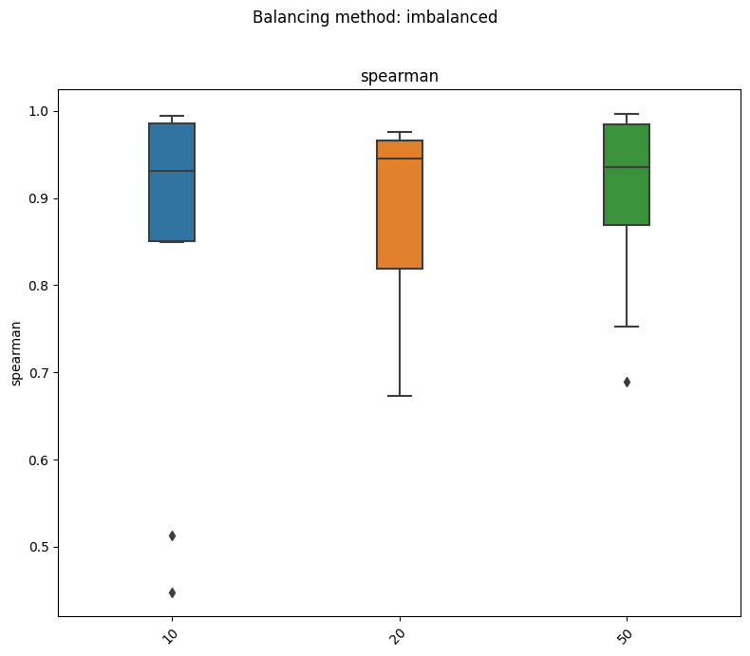
Calibration

Slide 44
XAI Are balanced models more similar to original or imbalanced models?
 | mean | median | rejection rate
original | 0.4641 | 0.4536 | 0.0455
imbalanced | 0.3072 | 0.1179 | 0.2636
* Results based on experiments wits SVMs that had accuracy of at least 0.6

Slide 45
XAI Which method results in models the most similar to original model?
Balancing method | mean | median | rejection rate
Contextual_word_embedding | 0.5706 | 0.6581 | 0.00
LLama | 0.4978 | 0.5277 | 0.05
LLama_complex | 0.5217 | 0.5681 | 0.00
ROS | 0.5391 | 0.5421 | 0.00
Spelling_mistake | 0.5583 | 0.5789 | 0.00
Summarization | 0.1970 | 0.1365 | 0.10
Synonym replacement | 0.5549 | 0.5944 | 0.00
Translation | 0.1153 | 0.0946 | 0.30
paraphrase | 0.5307 | 0.4390 | 0.00
* Results based on experiments wits SVMs that had accuracy of at least 0.6

Slide 46
XAI Comparing models with similar performance with f1 >= 0.8*f1 of original model
Are balanced models more similar to original or imbalanced models?
 | mean | median | rejection rate
imbalanced | 0.3693 | 0.1667 | 0.1222
original | 0.4567 | 0.4488 | 0.0444

Slide 47
XAI- good models Which method results in models the most similar to original model?
Balancing method | mean | median | rejection rate
Contextual_word_embedding | 0.5706 | 0.6581 | 0.0
LLama | 0.5158 | 0.5414 | 0.0
LLama_complex | 0.5284 | 0.5816 | 0.0
ROS | 0.5391 | 0.5421 | 0.0
Spelling_mistake | 0.5583 | 0.5789 | 0.0
Summarization | 0.1970 | 0.1365 | 0.1
Synonym replacement | 0.5549 | 0.5944 | 0.0
Translation | 0.1153 | 0.0946 | 0.3
paraphrase | 0.5307 | 0.4390 | 0.0
* Results based on experiments wits SVMs that had accuracy of at least 0.6

Slide 48
Conclusions (as of right now)
Most text augmentation methods turned out to be a disappointment hurting models performance instead of improving it and all of them are heavily dependent on imbalance ratio.
Not all methods are fit for use if we are interested in calibrated model ex. spelling mistake introduces too much noise poisoning the data.
Calibration is not affected by imbalance ratio.
Models built using balancing techniques are more similar to original model when it comes to XAI

Slide 49
Why so little?

Slide 50
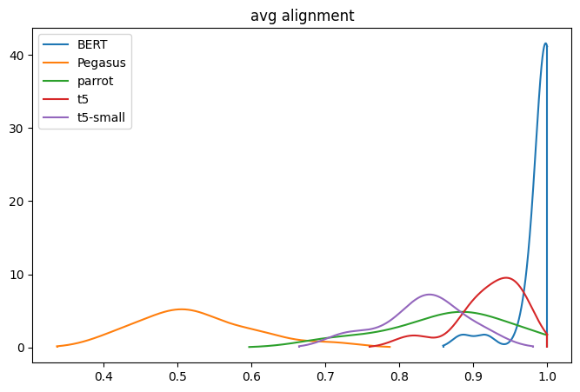
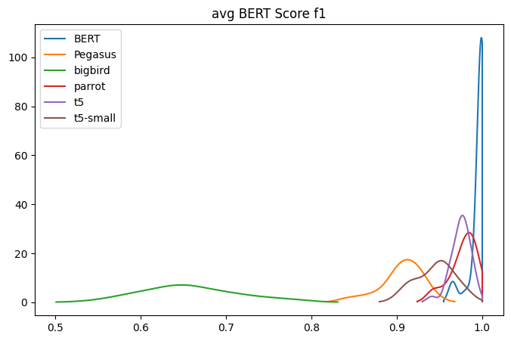
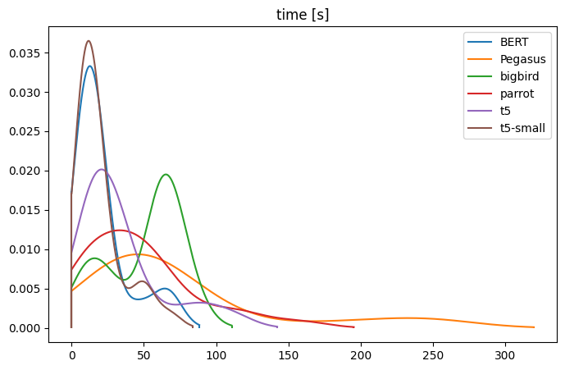
Paraphraser selection

Slide 51
Initial results
 | Imbalance ratio | 1 epoch |  | 3 epoch
 |  | batch 16 | batch 32 | batch 16 | batch 32
Imbalanced | 1:20 | 0.5208 | 0.5208 | 0.5208 | 0.5208
Synonym | 1:20 | 0.5208 | 0.5260 | 0.5260 | 0.5260
ROS | 1:20 | 0.6458 | 0.6875 | 0.5781 | 0.5729
Paraphrase | 1:20 | 0.5260 | 0.5260 | 0.5885 | 0.5313
Imbalanced | 1:5 | 0.5208 | 0.5208 | 0.5208 | 0.5208
Synonym | 1:5 | 0.5469 | 0.5365 | 0.5938 | 0.6563
ROS | 1:5 | 0.8073 | 0.7656 | 0.7396 | 0.7448
Paraphrase | 1:5 | 0.5990 | 0.5469 | 0.6719 | 0.6667
Original |  | 0.7708 | 0.7865 | 0.8385 | 0.8594

Slide 52
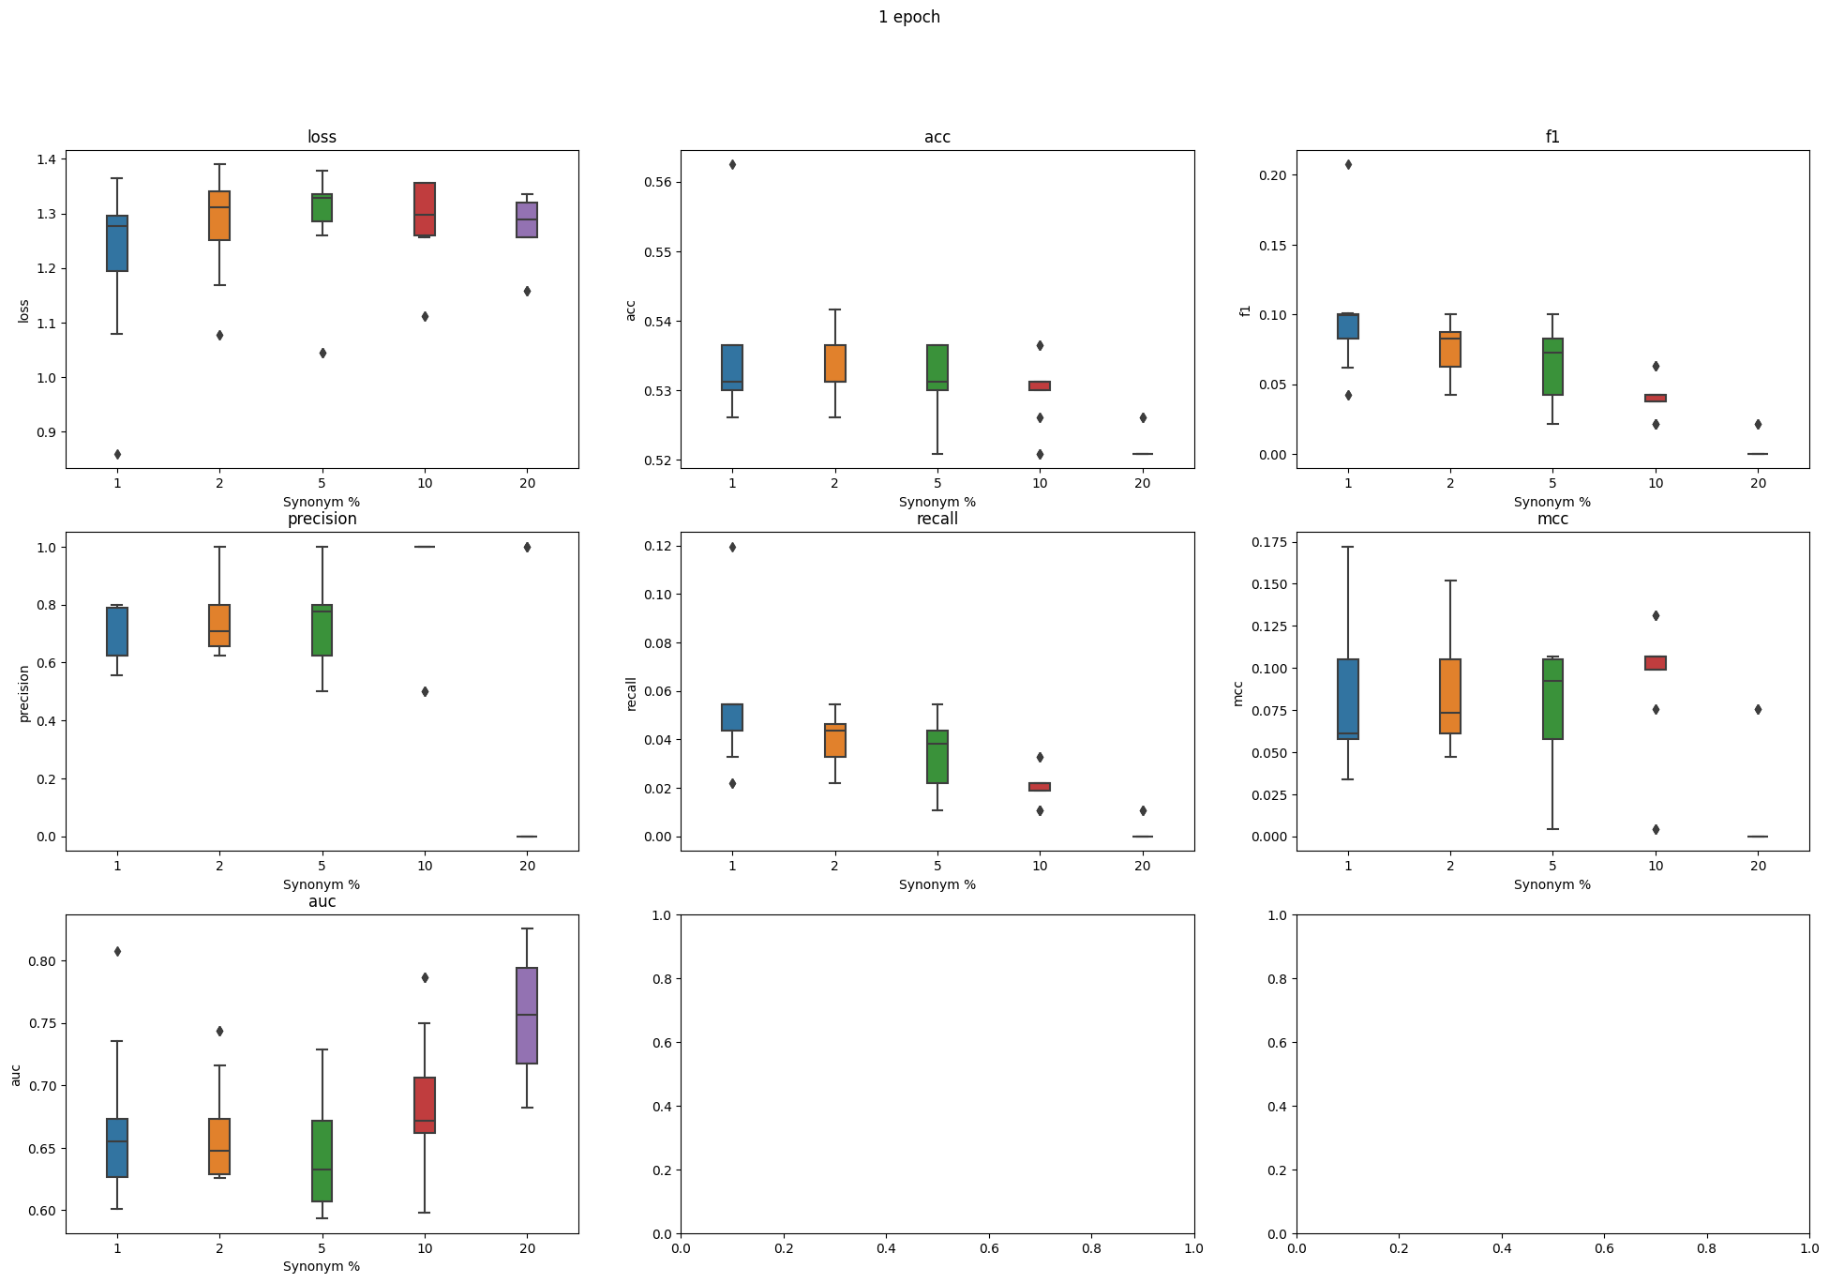
Remedy

Slide 53
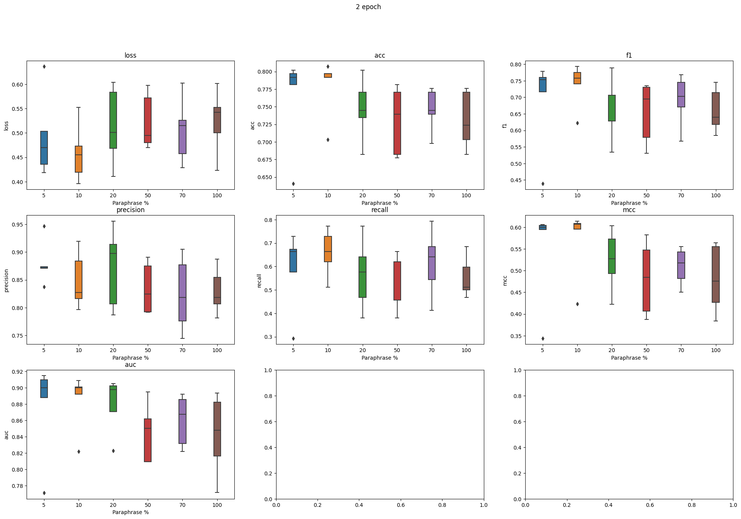
Remedy

